Slide 1
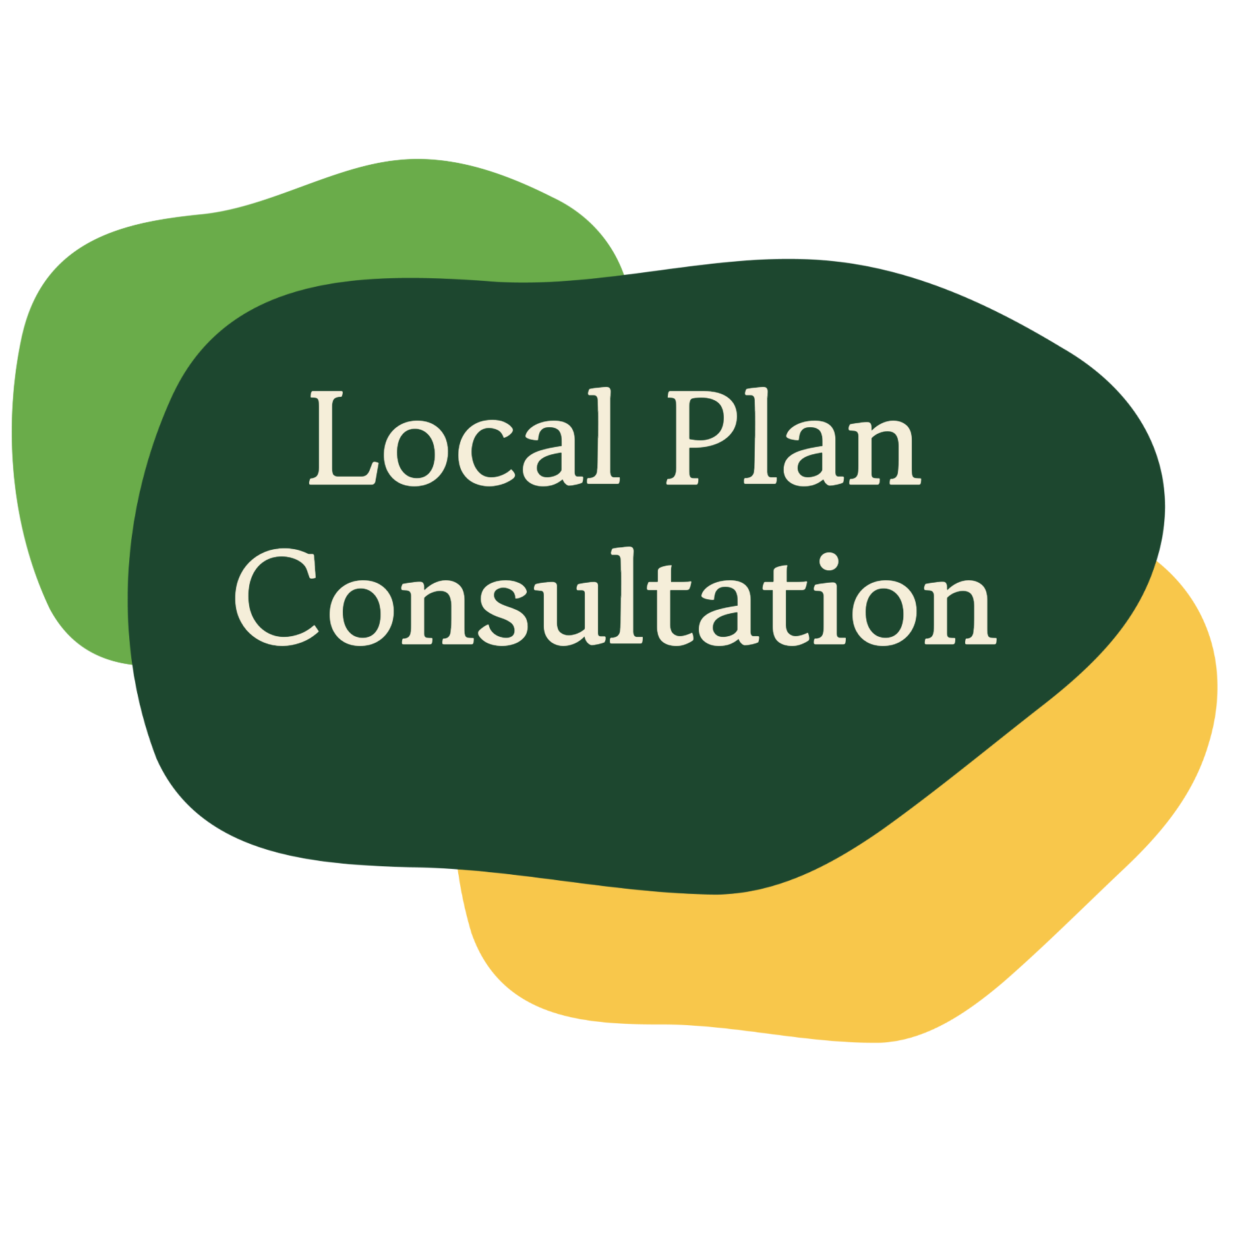
Juliet Layton
Deputy Leader / Housing & Planning portfolio holder
Cotswold District Council
Jo Symons
Head of Planning Policy
Cotswold District Council

Slide 2
What’s happened and what’s changed this year?
The government has > doubled the district’s housing target, based on affordability ratios
This means we no longer have a 5-year housing land supply
This makes it much more challenging to refuse planning applications for housing
1,036
per year
…but, there is a significant affordability challenge in the district, so we need to build new, affordable homes.
475
per year
Notes:
In November last year the Government introduced new mandatory housing targets.
Overnight this meant out housing target more than doubled.
Overnight our HLS went from 7 years to 1.8.
This had several implications:-
We no longer had a five year housing land supply as required by government.
The housing policies in the adopted Local Plan were considered to be "out of date". The rest of the plan remains sound.
This opens the way for speculative planning applications on non allocated sites, and such planning applications would be considered against national planning policy – i.e. harder to refuse in some cases.
This could lead to less sustainable, piecemeal development and reduces the LPAs ability to ensure adequate infrastructure is provided to support the growth.
So what are we doing?

Slide 3
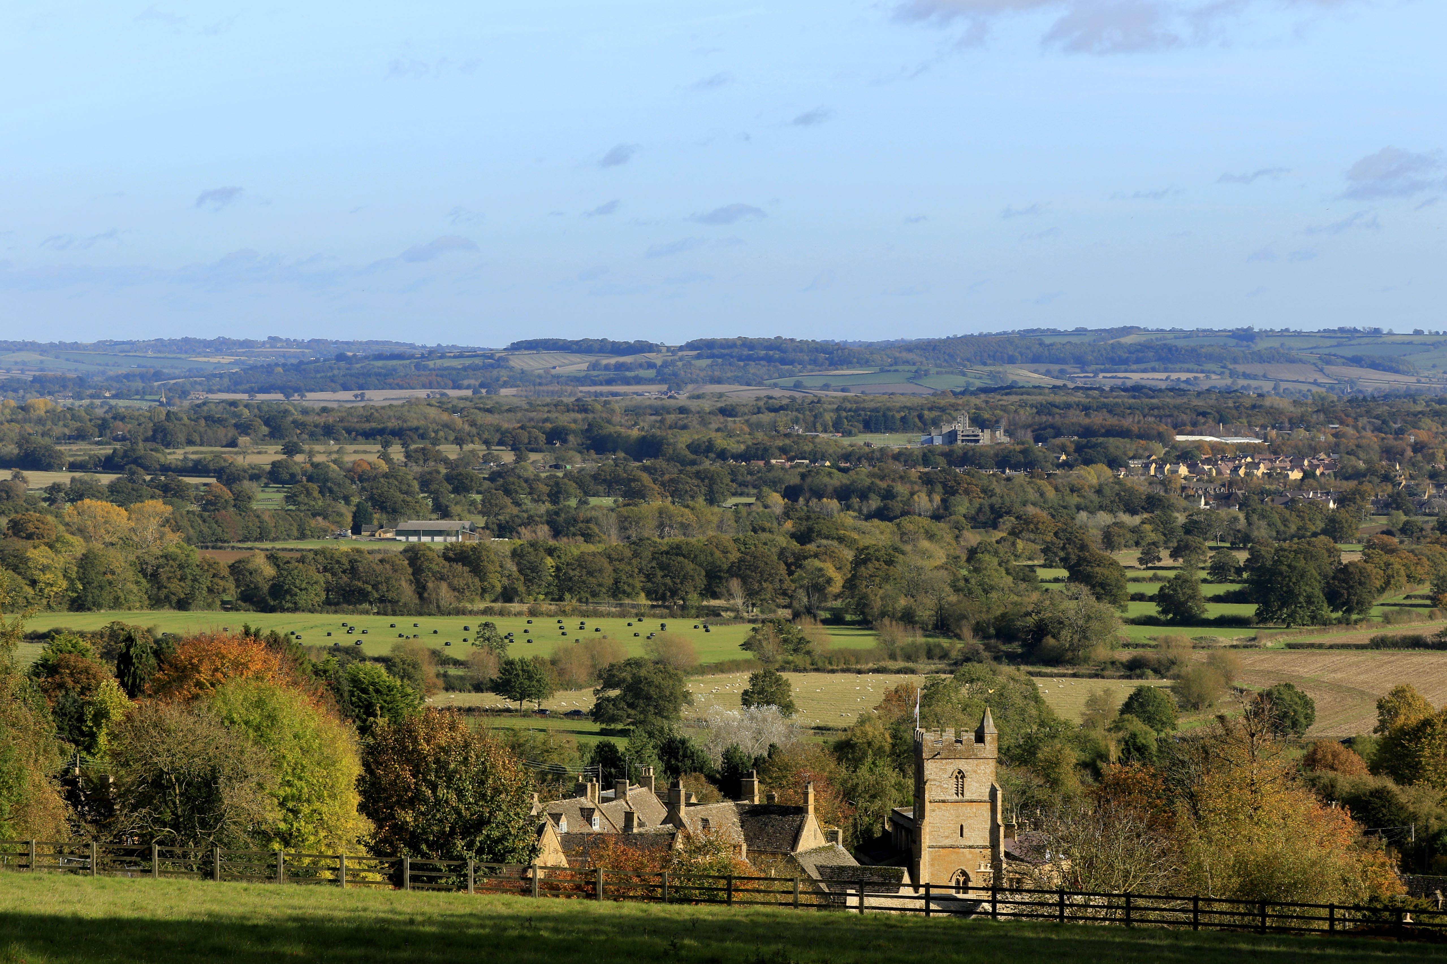
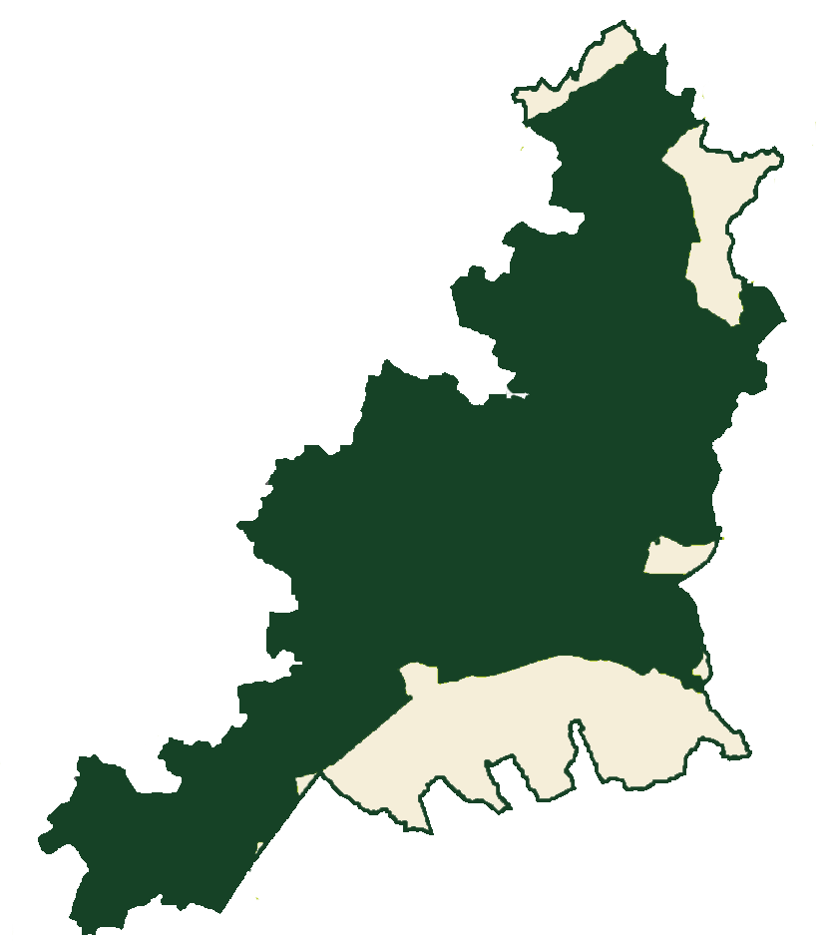
What are we doing?
New targets mean we must look across the whole district..
Make provision for infrastructure
…but we can’t plan for development (at scale) on 84% of land in the district…
Communities get a say!
…undertaking a full update of our Local Plan
Align development with community needs and growth ambitions
We control development, not developers
Development is plan-led, not piecemeal
Notes:
As a result of these national changes the Council approved in July this year to progress at pace with a full local plan, bringing together work underway since June 2020 on updated policies and potential allocations.
This is the quickest way to regain our 5YHLS and therefore control over unplanned, piecemeal development. It allows us to ensure the required infrastructure. It also means we move into the new unitary authority in 2028 with an adopted plan that will travel with us and steer development until the new authority replaces it with its on spatial plan which may take up to five years.
However, this is not without its challenges. The housing numbers have doubled, we still need adequate affordable housing, and critically 80% of the district is national Landscape and another 4% subject to flood constraints , heritage constraints or already built on. The challenge this presents is evident in the map graphic on the slide.
As a result the consultation document sets out a number of growth strategies of which there is more in a minute.

Slide 4
Timeline, further evidence being gathered & opportunities to engage
Reg.19 dependent main evidence base (#3)
Dependent evidence (#1)
Broad Locations Study
Settlement Role & Function Study
December 2024: new government housing targets
Dependent evidence (#5)
Strategic site viability assessment
Submission of the Local Plan to the Inspectorate
Reg.19 consultation (6 weeks)
Reg.18 consultation sign off
June
2020
July 2025
Sept
2025
Nov
2025
Dec 2025
March
2026
April
2026
June
2026
June- Aug
2026
Aug -Nov
2026
Dec 2026
Oct 2025
Review started 2020
2022 – early 2024: initial consultation and draft strategy
Reg.18 consultation launch (7 weeks)
Dependent evidence #4 Transport Modelling
& Infrastructure Delivery Plan
Development of the final draft Local plan and supporting evidence
Reg.19 consultation sign off
Examination in public - 2027
Dependent evidence (#2)
Integrated Impact Assessment
Strategic Housing and Economic Land Availability Assessment Update
Moreton-in-Marsh Feasibility Study Part 1
Notes:
This timeline shows the activity from the start back in the summer 2020 through to when we submit our final draft plan to the Planning Inspectorate in 2026.
So we are currently here – about to go out to consultation on our issues and options paper – known in planning jargon as the Regulation 18 stage after the relevant part of the legislation that governs local plan production. During the consultation we will also make another call for sites which may bring forward new potentially available land.
To get to this point has involved a number of key pieces of evidence gathering such as board locations study and settlement role and function study..................i will come back to how these have informed this stage in a little more detail in a minute.
After this consultation we will review all the representations made, make any required amendments to potential sites and policies and then undertake further evidence gathering and due diligence such as looking at the impact of potential developments on the road network, what infrastructure would be required to support the growth (not just transport but schools, health provision and so on), and crucially viability assessment of these larger sites. can the amount of development proposed support the level of infrastructure growth required to support it – i.e. the land may be available but is development deliverable.
If sites are no longer available, and/or after due diligence not viable they will not travel forward to the next stage of the plan. Both have to be demonstrated to convince an inspector the plan is "sound".
We then produce a final draft plan – at which point site allocations will be made and consult again -known as Reg 19 stage.
Consultation responses feed in the final draft and then we submit to the Planning Inspectorate at the end of 2026. During 2027 an examination in public will be held, the inspector will report later that year and then the council, assuming the plan to be found sound, will move to adopt before the end of 2027.

Slide 5

Strategy options
…we’ve set out 7 options for doing this
The government wants the council to plan for
18,650
new homes between now and 2043…
…that means finding sites for
12,500
additional homes
6150
homes already in the pipeline that can contribute…
Our preferred option (Scenario 5) would deliver
14,660 homes
79% of target
Notes:
So as we have already set out we need to provide for 18,650 homes between now and 2043. We know we can expect to see over 6000 of these homes come forward from sites that already have the benefit of planning permission, windfall sites likely to come forward and sites already allocated in the current local plan but not yet consented that came forward in previous calls for sites.
The exhibition boards set out 7 possible development scenarios – the last two are discounted as not deliverable.
Of the remaining scenarios, the preferred option is Scenario 5 – this is allocating in principle settlements, non principal settlements, and village clusters. Support rural exception sites, create new settlement(s) and/or strategic extensions to existing. In short this means considering putting forward all land that we currently believe to be available and deliverable in the district that is not heavily constrained.
Even when we consider this, scenario five would only deliver 14,660 homes or 79% of the target.
This means DTC with our neighbours
May submit short of the housing need

Slide 6
Option 5 broken down:
Two largest towns outside of National Landscape (Cirencester & Moreton) proposed to take the most new housing
Growth in principal settlements:
5,995 new homes
At least 1,575 of these new homes in principal/non-principal settlements across Cotswold National Landscape (+ more in rural/open countryside)
6,816
new homes on 8 strategic sites
Option 5:
14,660 homes
Growth in non-principal settlements:
1,103 new homes
24 / 29
of the district’s principal and non-principal settlements could see growth of 10%+
748
new homes in other rural settlements and open countryside
Principal settlement:
A main town or large community
Non-principal settlement:
A smaller village or community
Notes:
Would need to explain at this point what principal and non-principal settlements are…
Growth figures in principal and non-principal settlements includes existing planning consents

Slide 7
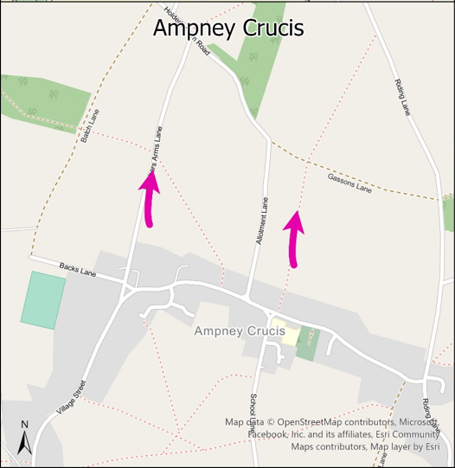
What could this mean for Ampney Crucis?
Outside of National Landscape
Land indicated as being available
Current settlement size is 246 homes, classed as a Rural Settlement
In our preferred development
option strategy:
660 (estimated) new dwellings up to and beyond 2043
High level indication of the location of the potential new strategic site
Notes:
So what does this mean for Moreton?
The broad location studies and settlement role and function studies have identified areas that could take housing growth.
Those studies have reconfirmed Moreton is a sustainable location that COULD take growth – based on the facilities it has and the transport links it has.
The previous call for sites, extant planning permissions and allocations in the previous plan (as yet undeveloped) have all informed what sites have been identified as available for housing.
The numbers of potential home that could be delivered in this plan period, and beyond are indicative. No sites have been allocated, no infrastructure work concluded yet. Therefore we do not know if these areas of growth are deliverable.
But we do know that larger scale strategic sites do help us to justify infrastructure.
As you are aware a feasibility study was commissioned for Moreton – this work is just concluding but does not as it stands provide all that we need to demonstrate the solutions work or that they could be funded . Also there are now 8 potential strategic growth areas that may need to be assessed. So as we move to the next stage we will commission transport feasibility works across all these sites that will look at more detailed work on the costings of the bypass, other sustainable transport solutions, car parking and park and ride options. And we will assess the viabilyt of these sites and infrastructure.
Draft findings of the study suggest that the cost of some of the solutions – such as the bypass – will likely be prohibitive. It would cost in the region of £30k per dwelling if 5000 homes were built. There would still be the need for further external funding to be found.

Slide 8
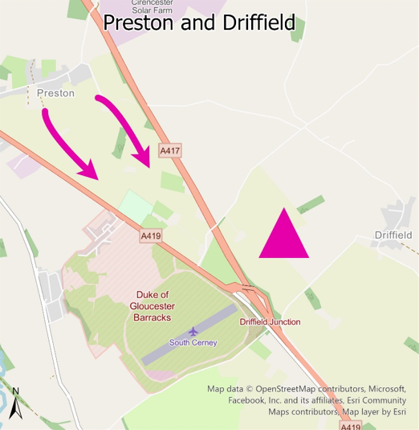
What could this mean for Driffield?
Outside of National Landscape
Land previously indicated as being available
In our preferred development
option strategy:
New settlement west of Driffield
840 (estimated) new dwellings in 25 – 43 plan period
1,260 more (estimated) beyond 2043
High level indication of the location of the potential new strategic site
Notes:
So what does this mean for Moreton?
The broad location studies and settlement role and function studies have identified areas that could take housing growth.
Those studies have reconfirmed Moreton is a sustainable location that COULD take growth – based on the facilities it has and the transport links it has.
The previous call for sites, extant planning permissions and allocations in the previous plan (as yet undeveloped) have all informed what sites have been identified as available for housing.
The numbers of potential home that could be delivered in this plan period, and beyond are indicative. No sites have been allocated, no infrastructure work concluded yet. Therefore we do not know if these areas of growth are deliverable.
But we do know that larger scale strategic sites do help us to justify infrastructure.
As you are aware a feasibility study was commissioned for Moreton – this work is just concluding but does not as it stands provide all that we need to demonstrate the solutions work or that they could be funded . Also there are now 8 potential strategic growth areas that may need to be assessed. So as we move to the next stage we will commission transport feasibility works across all these sites that will look at more detailed work on the costings of the bypass, other sustainable transport solutions, car parking and park and ride options. And we will assess the viabilyt of these sites and infrastructure.
Draft findings of the study suggest that the cost of some of the solutions – such as the bypass – will likely be prohibitive. It would cost in the region of £30k per dwelling if 5000 homes were built. There would still be the need for further external funding to be found.

Slide 9
Beyond 2043: other strategic sites
Strategic sites (500 homes or more) | Estimated homes up to 2043 | Estimated homes up to and beyond 2043
Strategic extension north of Ampney Crucis | 660 | 660
Strategic extension south of The Steadings, Cirencester | 400 | 1,290
New settlement west of Driffield | 840 | 2,100
Strategic extension north-east of Fairford | 780 | 1,400
Strategic extension south-west of Kemble | 590 | 1,070
Strategic extension north, south and east of Moreton-in-Marsh | 1,710 | 3,970
Strategic extension south of Preston | 960 | 2,510
Strategic extension north, south and west of Siddington | 880 | 1,100
Notes:
The broad location studies and settlement role and function studies have identified areas that could take housing growth. The housing growth in principal and non principal settlements are displayed on the boards. But to meet the total numbers required we also need to consider new settlements and strategic sites.
And whilst this consultation primarily focusses on options to deliver development needs up to 2043, some of the strategic sites would likely grow well beyond this. Importantly, if the indicative strategic sites are allocated in the Local Plan, the total number of homes expected to be delivered by these sites would be allocated, even though much of the development would be expected after 2043 .
This is because where strategic sites are required to deliver the housing numbers supported by sufficient infrastructure, we must plan at least 30 years ahead for these sites to make sure they are well designed and sustainable.
The indicative total sizes of the potential strategic sites are provided on the screen and on the exhibition boards.
So to reiterate, the lower number is the indicative figure expected to be delivered in this new local plan period. the right hand column the total delivered in this plan period and beyond 2043.
Cannot give a end date....................

Slide 10
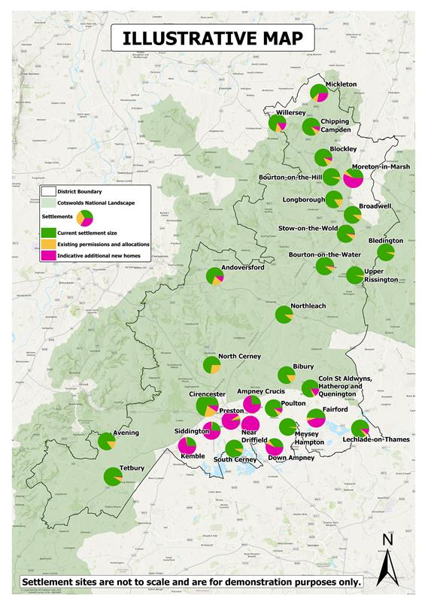
What does this mean for the district? South
Key
District boundary
Cotswold National Landscape
Current settlement size
Existing permissions & allocations
Indicative additional new homes
Notes:
So what does this mean for the south of the district? If you have not done so already I would encourage you to review these plans on the boards or online.
Each pie chart shows the current size of the settlement in green, the existing planning permissions and site allocations in yellow and the indicative amount of additional new homes in pink. The latter includes the ‘Total Potential’ figure. So up to and beyond 2043.

Slide 11
What does this mean for the district? North
Key
District boundary
Cotswold National Landscape
Current settlement size
Existing permissions & allocations
Indicative additional new homes
Notes:
And for the north
The numbers of potential home that could be delivered in this plan period, and beyond are indicative. No sites have been allocated, no infrastructure work concluded yet. Therefore we do not know if these areas of growth are deliverable.
But we do know that larger scale strategic sites do help us to justify infrastructure.
There are now 8 potential strategic growth areas that may need to be assessed. So as we move to the next stage we will commission transport feasibility works across all these sites that will look at more detailed work on the costings of the infrastructure required to support the growth. And we will assess the viability of these sites and infrastructure.
Not all infrastructure may be deliverable, not all sites will remain available and therefore some of these may fall away before Reg 19. There is a further call for sites and therefore new, not previously considered sits may come forward for assessment.

Slide 12
You’re being consulted early in the process…
There is still a lot of work to do to test this option and these housing estimates, as set out here:
Development strategy options to meet government target
1. Your views from Nov-Dec-Jan consultation
2. Studies and evidence to test these indicative numbers for viability, including: studies on sewage and water supply, infrastructure, transport modelling, housing and economic need assessments etc.
3.Call for further sites
4. Conversations with neighbouring authorities
5. Continued engagement with government
6. Future stages to look at employment land
Sites allocated, full draft of plan, before further consultation.
Final numbers and locations TBD.
Further consultation and refined numbers in Summer 2026
We are here
Notes:
So what does this mean for Moreton?
The broad location studies and settlement role and function studies have identified areas that could take housing growth.
Those studies have reconfirmed Moreton is a sustainable location that COULD take growth – based on the facilities it has and the transport links it has.
The previous call for sites, extant planning permissions and allocations in the previous plan (as yet undeveloped) have all informed what sites have been identified as available for housing.
The numbers of potential home that could be delivered in this plan period, and beyond are indicative. No sites have been allocated, no infrastructure work concluded yet. Therefore we do not know if these areas of growth are deliverable.
But we do know that larger scale strategic sites do help us to justify infrastructure.
As you are aware a feasibility study was commissioned for Moreton – this work is just concluding but does not as it stands provide all that we need to demonstrate the solutions work or that they could be funded . Also there are now 8 potential strategic growth areas that may need to be assessed. So as we move to the next stage we will commission transport feasibility works across all these sites that will look at more detailed work on the costings of the bypass, other sustainable transport solutions, car parking and park and ride options. And we will assess the viabilyt of these sites and infrastructure.
Draft findings of the study suggest that the cost of some of the solutions – such as the bypass – will likely be prohibitive. It would cost in the region of £30k per dwelling if 5000 homes were built. There would still be the need for further external funding to be found.

Slide 13
Points to note:
Figures are indicative.
No site allocations being made at this stage.
Sites remain subject to consultation, evidence gathering, and infrastructure feasibility.
Some sites may not progress to the next stage of the Local Plan update (Regulation 19) if found unsuitable, unachievable or unavailable.
Plan still falls short of the government’s 18,650-home target for 2025–43, providing a supply of only 14,660 homes.
Notes:
So just to reiterate.............................................

Slide 14
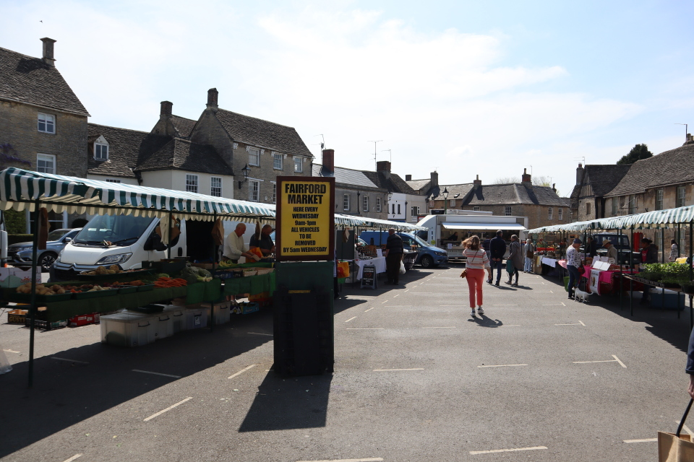
In the meantime…
Every planning application is consulted on…
The council can’t control where developers apply to build…
…but we will continue to assess every application on its merits.
…and despite the “tilted balance”, we aren’t afraid to recommend the committee refuses unsuitable development.
…but we will continue to rigorously assess every application on its merits.

Slide 15
Have your say:
Consultation
exhibitions
Mickleton: King George’s Hall, Friday 28 November, 2pm – 7pm
Moreton: St David’s Centre, Friday 5 December, 2pm- 7pm
Regulation 18 consultation
(on Preferred Development Strategy & beyond 2043)
Opened YESTERDAY for 7 weeks, closing Friday 2nd January
Fairford: Community Centre, Thursday 11 December, 2pm – 7pm
Cirencester: Corinium Museum, Thursday18 December, 2pm- 7pm
Town & Parish Council Forums (invite only)
Wednesday 5th November
Redesdale Hall
Notes:
So during the next stage of consultation there are a number of critical dates to be aware of here communities can become involved.
Important that formal representations are made. Please help us by informing communities, making representations early and submitting them online where possible.

Slide 16
Making it count…
Non-material considerations: cannot be considered in planning decisions
Material considerations:
matters that are relevant to the use and development of land
Examples:
Examples:
Loss of property value
Impact on amenity
Private rights (covenants/ boundary disputes)
Highway safety and traffic
Personal circumstances
Design and appearance
Business
competition
Private matters
Not issues that could be covered by other legislation or civil matters
Environmental impact
Economic benefits
Public interest
Land use planning matters
Based on fact & evidence
Social considerations
Planning history
Notes:
So during the next stage of consultation there are a number of critical dates to be aware of here communities can become involved.
Important that formal representations are made. Please help us by informing communities, making representations early and submitting them online where possible.

Slide 17
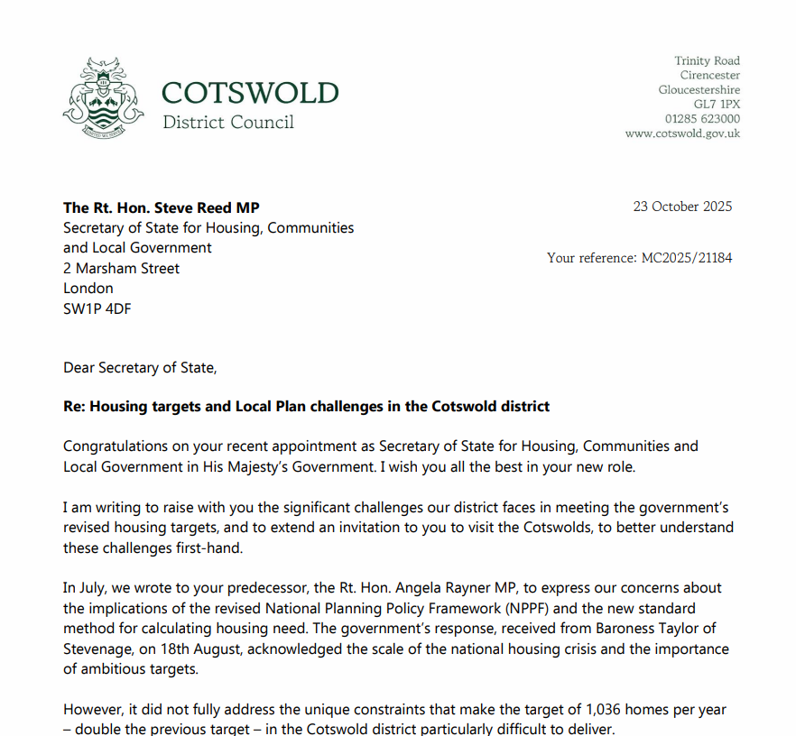
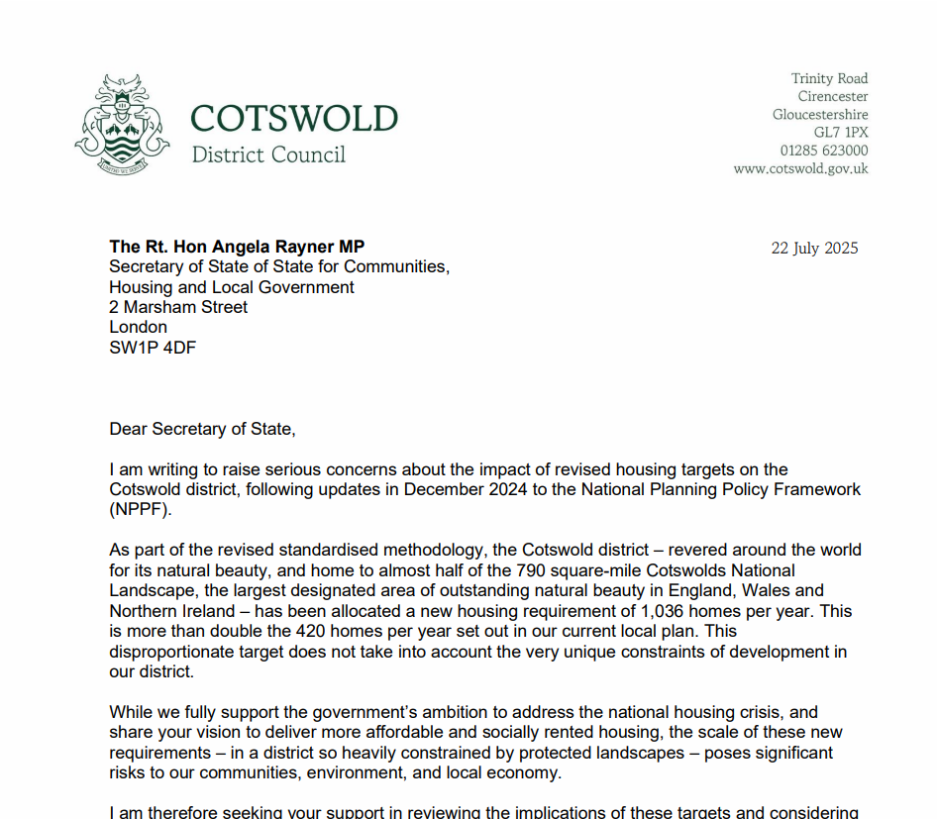
Taking the issue to government
Opposed method for calculating target during consultation in 2024
Engaged MPs on the matter
Written to government on two occasions
Reply to initial letter cited we “need to do our bit” re: housing, and targets are high because of affordability
Second letter requests a meeting with the government – no reply yet
Engaging other partners – many councils are affected by this

Slide 18
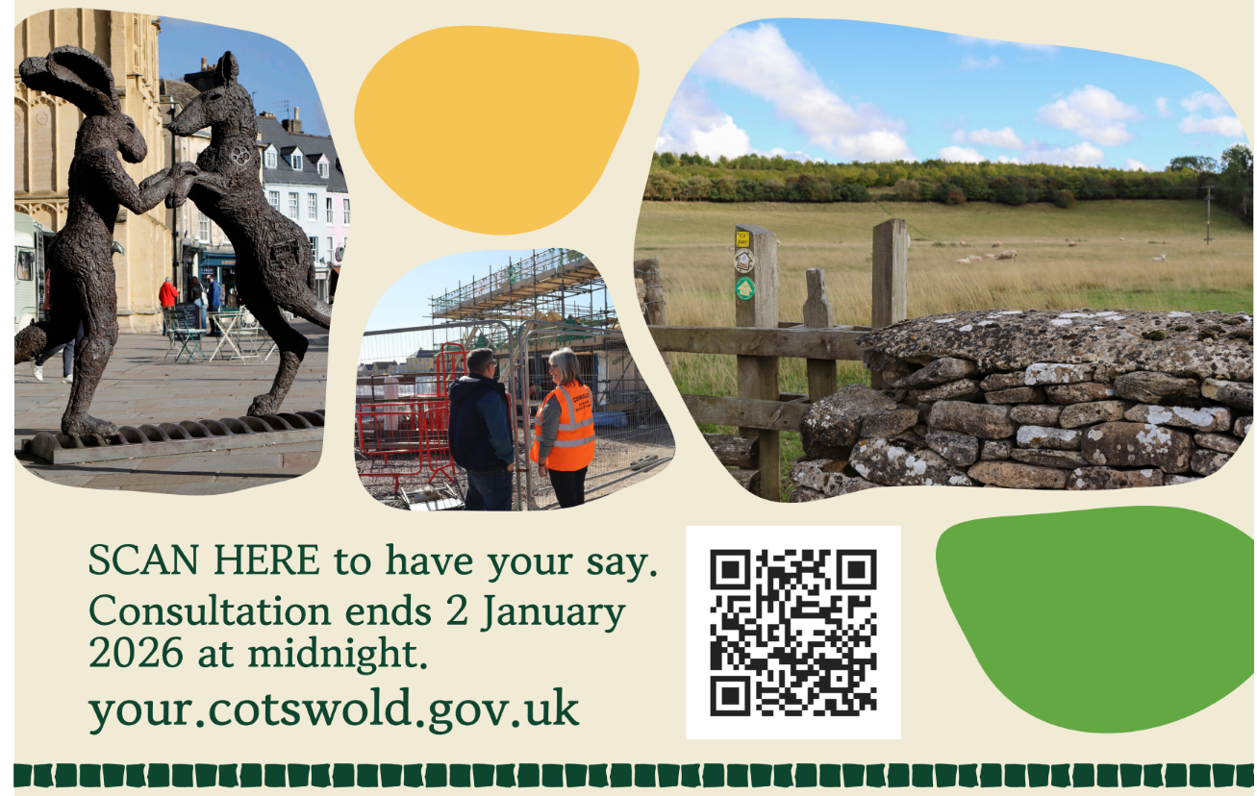

Slide 19
Questions

